Slide 1
Household Electric Power Prediction
Machine Learning Portfolio Project
Ahmed Ali
Prepared for WeCloudData Data Science Diploma
August 12th, 2022

Slide 2
Contents
1. Dataset description
2. Forecasting applications and prediction
3. Exploratory data analysis
4. Machine learning solution
5. Deep learning solution
6. Conclusion and future work

Slide 3
Dataset Description
Electric power consumption of a house near Paris, France
Over 2 million rows of measurements
One-minute sampling
A period of nearly 4 years (December 2006 – November 2010)
Nine (9) attributes of date, time, active power, reactive power, voltage, intensity and 3 sub-metering

Slide 4
Forecasting Applications and Prediction
Forecasting is a very important data science specialization with multitude application in all commercial business, industrial business, social sciences, economical and political domain and others
Traditionally, different univariate models (such as ARIMA, SARIMAX, Prophet, Neural Prophet) and multivariate models (such as Vector Autoregression) are used
Machine Learning regressor models can also be used

Slide 5
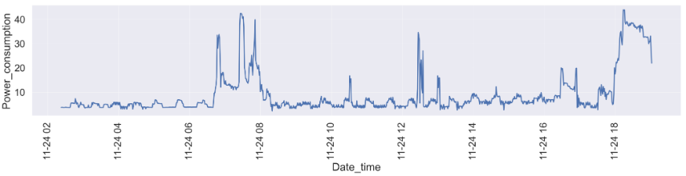
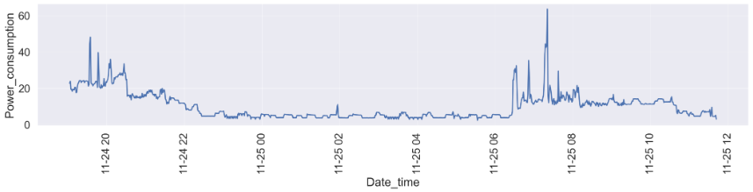
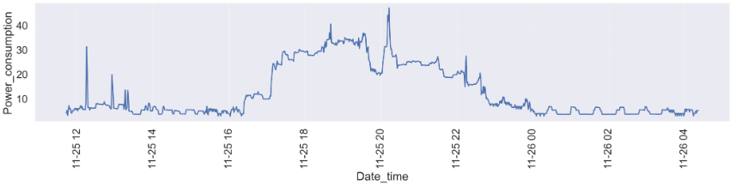
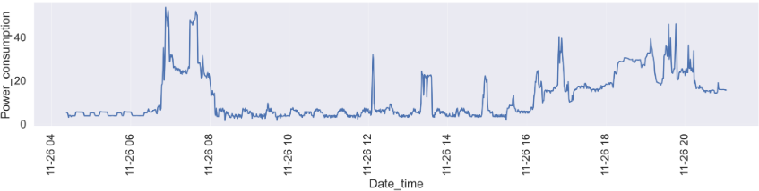
Exploratory Data Analysis (EDA)
The four (4) graphs show the trend of one-minute electric power consumption over two days
The minute consumption fluctuates around 5 kW during most of the day
The minute consumption peaks around 6-8am and 6-10pm

Slide 6
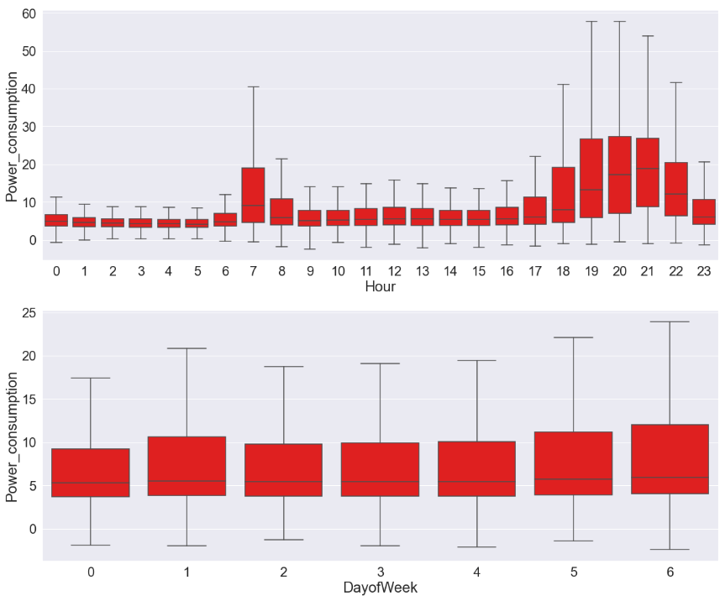
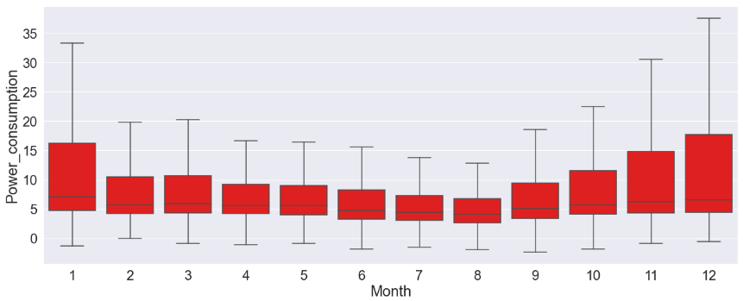
Exploratory Data Analysis (EDA)
The distribution of average hourly electric power consumption matches the minute trends
The distribution of average monthly consumption is wider on the weekend
The distribution of average monthly consumption is wider between November and January

Slide 7
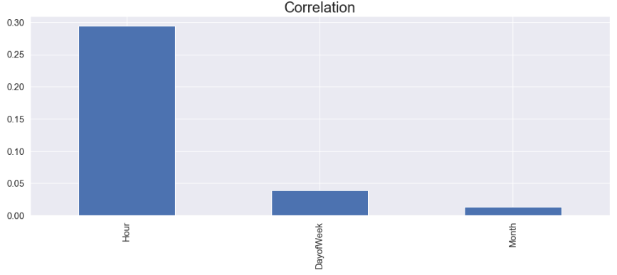
Exploratory Data Analysis (EDA)
Based on the previous analysis, four (3) new features were engineered from the date and time, to be used in the Machine Learning modelling
The correlation numbers show that the Hour is the highest time-related feature that affects the electric power consumption

Slide 8
Machine Learning Solution
The engineered features were used as input to construct three different ML models
Mean Squared Error (MSE) and R2 were used as metric to evaluate the performance
Logistic Regression was used to form a baseline
It performed poorly and that is due to the linear regression it produces

Slide 9
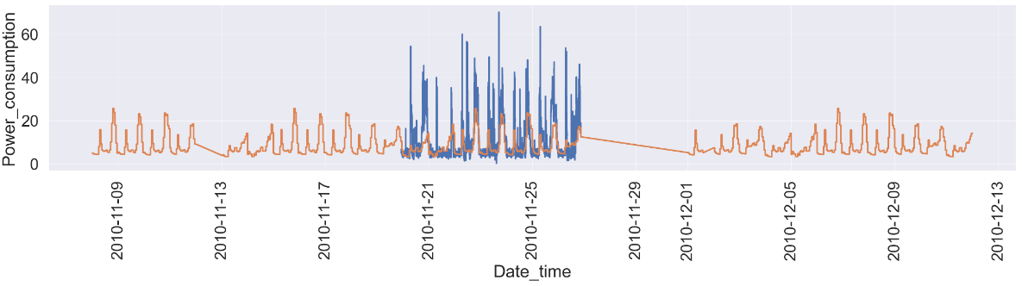
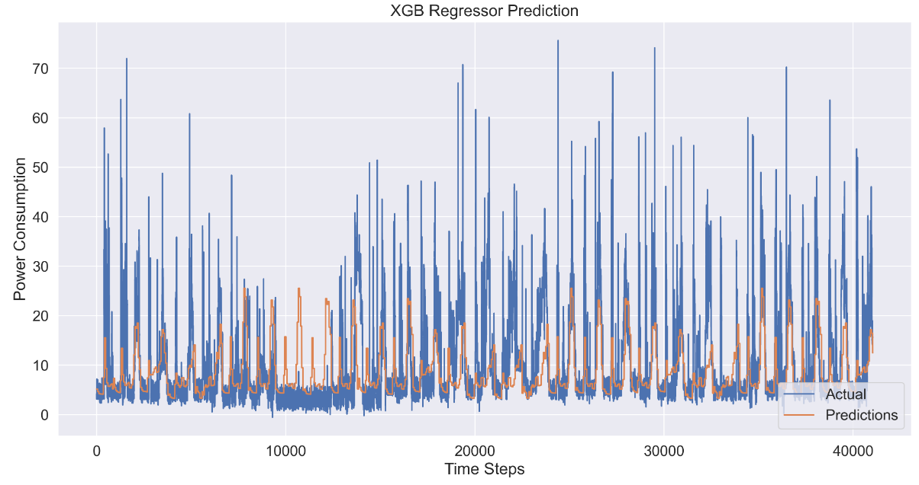
Machine Learning Solution
Decision Tree produced poor results. It could perform better with hyper-parameters tuning
XGB Regressor produced better results, as can be seen in the graph
The prediction trend repeats in certain pattern as it takes in account the time-related features over the whole training set

Slide 10
Deep Learning Solution
This problem needs a deep learning solution that takes in account the previous measurements to the ones to predict, regardless of the time components
LSTM algorithm is used for time-series, and thus a neural network based on it was modelled
Resampling the dataset into hourly dataset was carried out, to reduce the dataset size and to enable hourly prediction

Slide 11
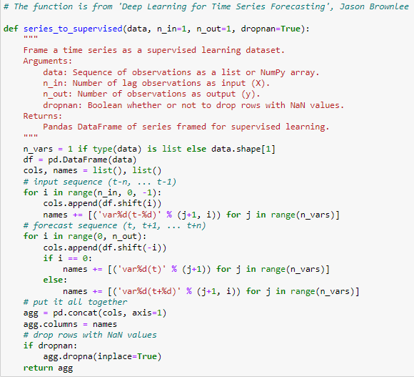
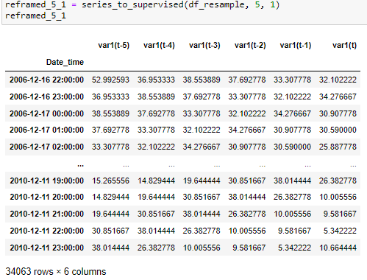
Deep Learning Solution
The time-series is firstly converted to a supervised learning problem by reshaping the measurements into an array of different time steps

Slide 12
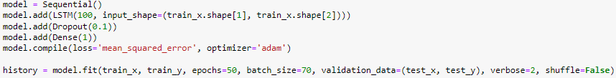
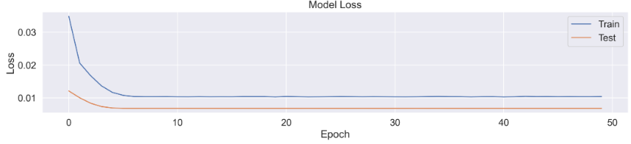
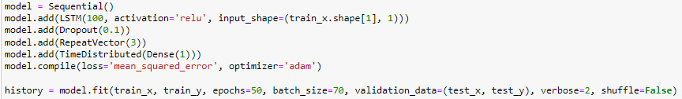
Deep Learning Solution
The dataset is then divided into training and testing, and an LSTM network is modelled
The solution converges with the choice of the above settings
LSTM network to predict several future points

Slide 13
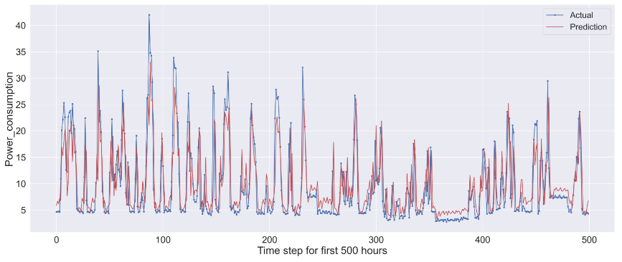
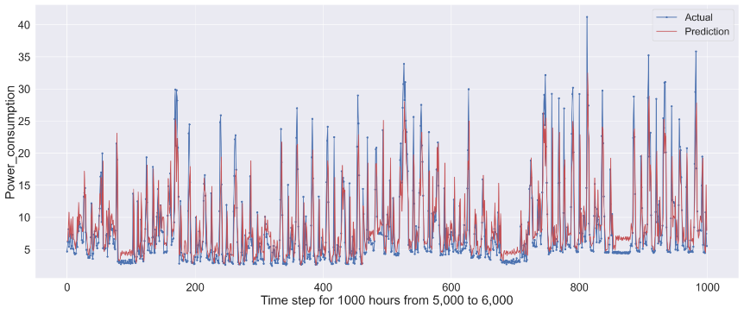
Deep Learning Solution

Slide 14
Conclusion and Future Work
Machine Learning algorithms can be used to solve time-series. However, the performance will not be satisfactory
The choice of engineered features is crucial in improving the predictions of time-series forecast
Looking into temporal change is important in engineering useful features
Non-linear ML algorithms such as XGB regression prove to produce results better than pre-determined average(s)

Slide 15
Conclusion and Future Work
LSTM produces more representative results than ML algorithms
Tuning the LSTM model is needed to improve results
Multi-step LSTM is next step as it enables producing several future predictions
Main goal in tuning the model is to balance the number of the previous measurements and the future ones, in order to produce results that are close to actual

Slide 16
References
Dataset:
https://archive.ics.uci.edu/ml/datasets/individual+household+electric+power+consumption
Deep Learning for Time Series Forecasting, Jason Brownlee
Code:
https://www.kaggle.com/code/winternguyen/predict-household-electric-power-using-lstm/notebook

